Slide 1

BHARATI VIDYAPEETH’S INSTITUTE OF COMPUTER APPLICATIONS AND MANAGEMENT (BVICAM)
(GURU GOBIND SINGH INDRAPRASTHA UNIVERSITY)
NEW DELHI
April, 2021
MINOR PROJECT
DESKTOP ASSISTANT
Mentor- Dr.Ritika Wason
(Associate Professor)
Submitted by
Riya Kumari Kushwaha
Enroll No. 03735304420

Slide 2
Content
Introduction
Problem Statement
Proposed Solution
Use case diagram
Class diagram
Object diagram
Package diagram
Activity diagram
Sequence diagram
State chart diagram
Communication diagram
Screenshots
Technology used
Future Scope and Conclusion
Bibliography

Slide 3
Problem Description
Ease of access to any application or file is quite complicated in desktop
We need to remember the path
Children and older people find it difficult to access desktop computers

Slide 4
Solution
Ease of access to files and application
We just have to speak the command to the desktop assistant
Saves human time and resource
Hands free operations

Slide 5
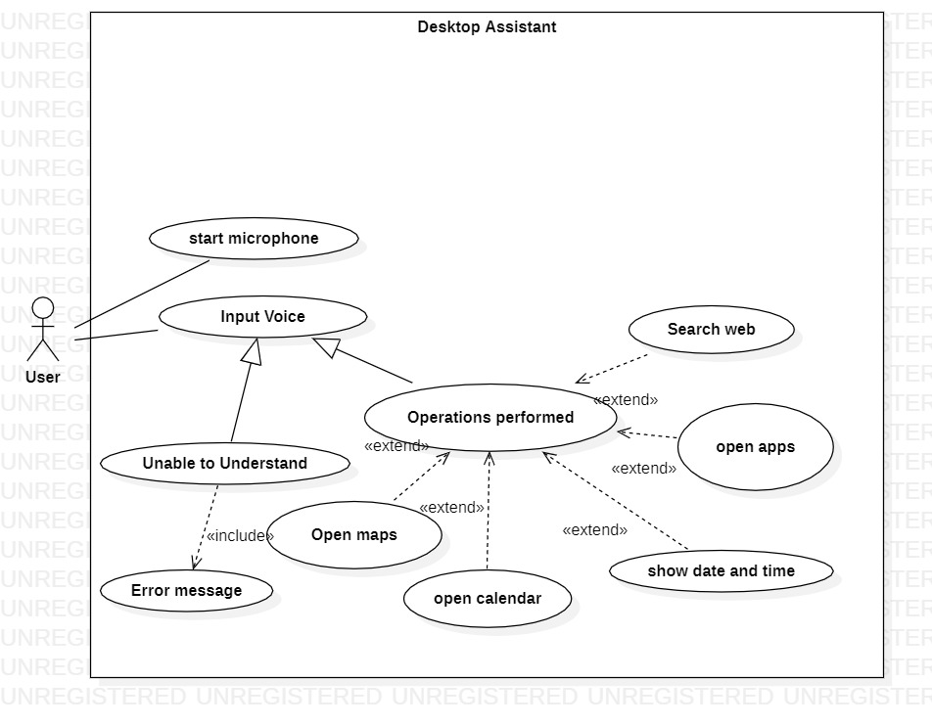
Use Case Diagram

Slide 6
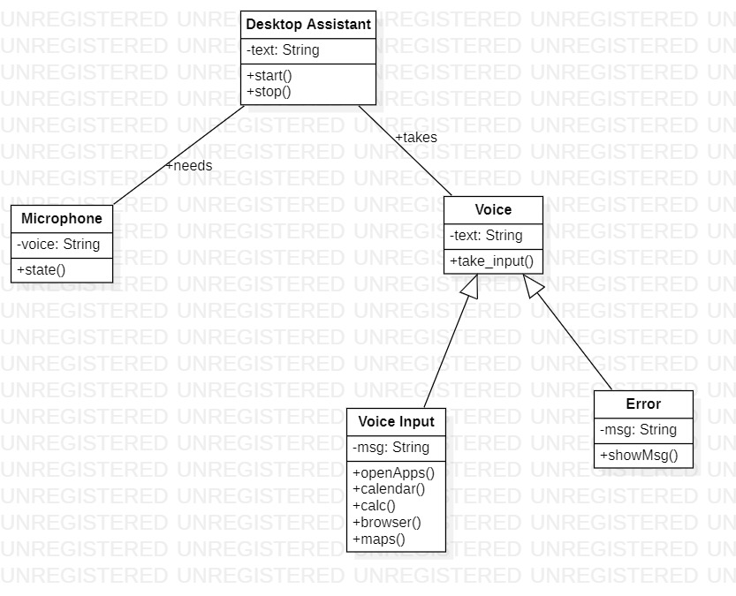
Class Diagram

Slide 7
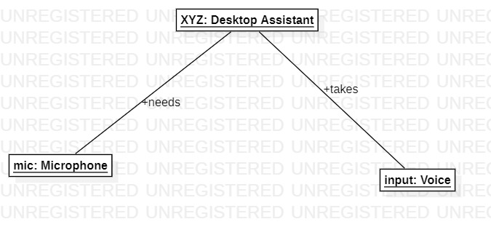
Object Diagram

Slide 8
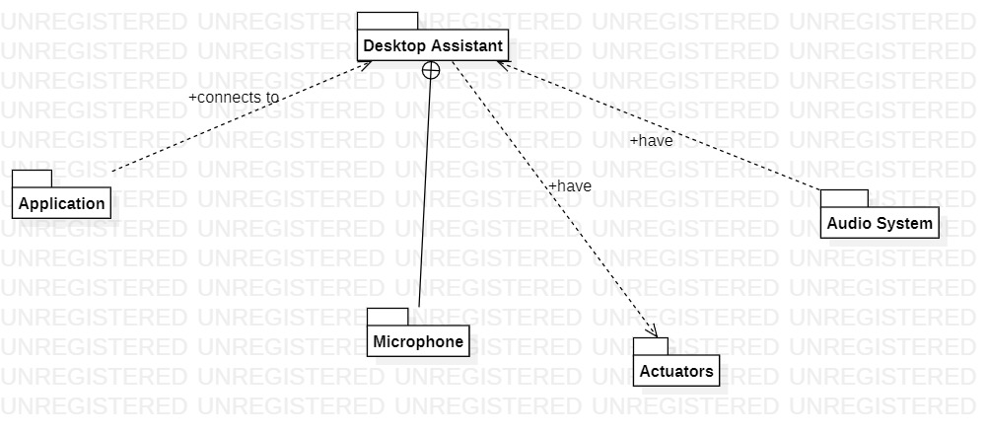
Package Diagram

Slide 9
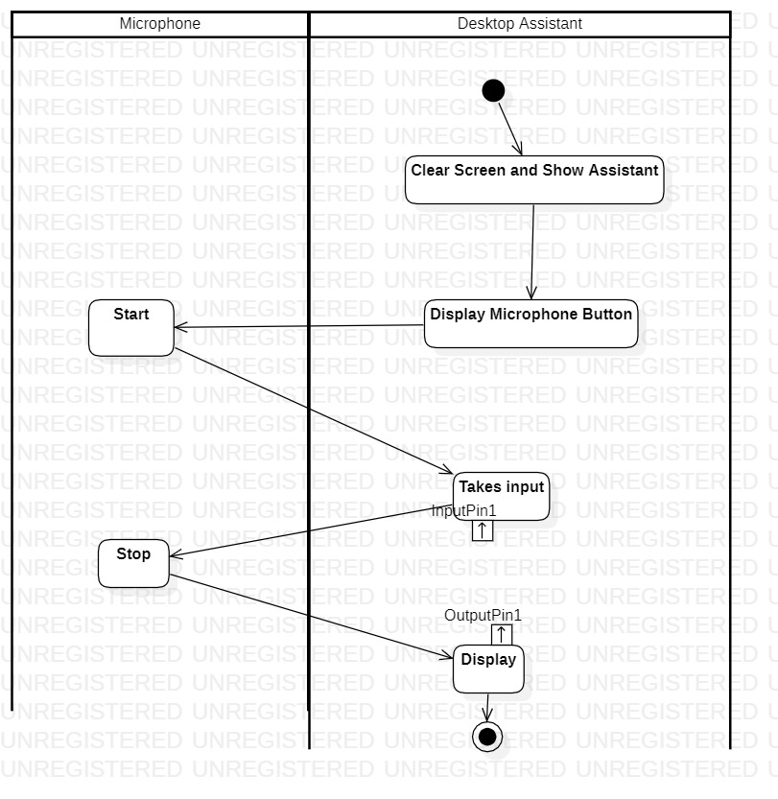
Activity Diagram 1.Microphone

Slide 10
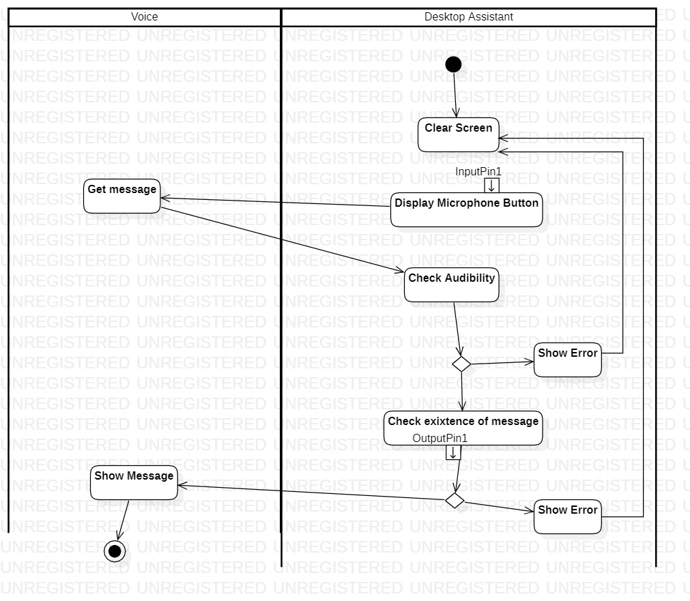
2.Voice

Slide 11
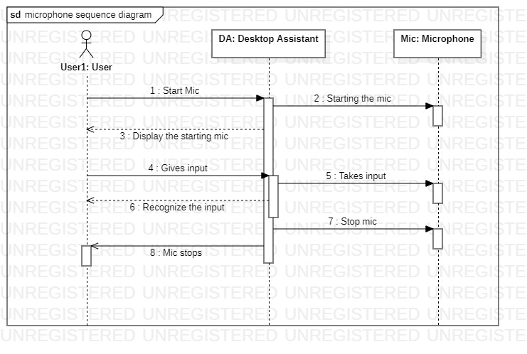
Sequence Diagram 1.Microphone

Slide 12
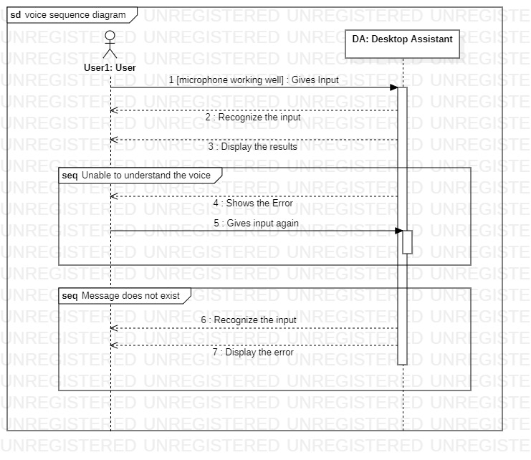
2.Voice

Slide 13
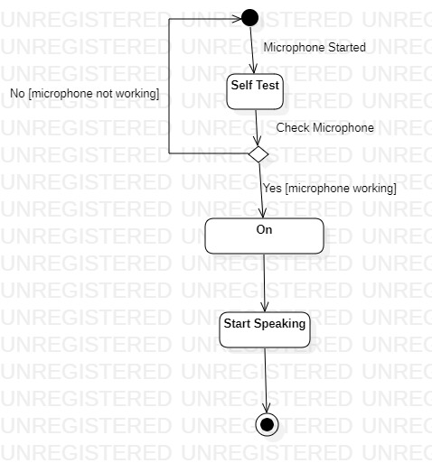
State Chart Diagram 1.Micrpohone

Slide 14
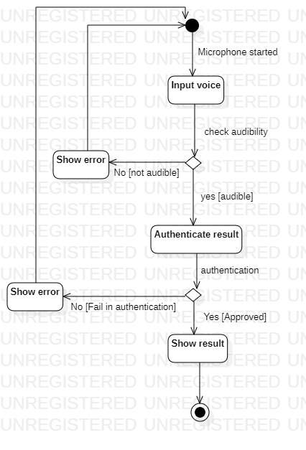
2.Voice

Slide 15
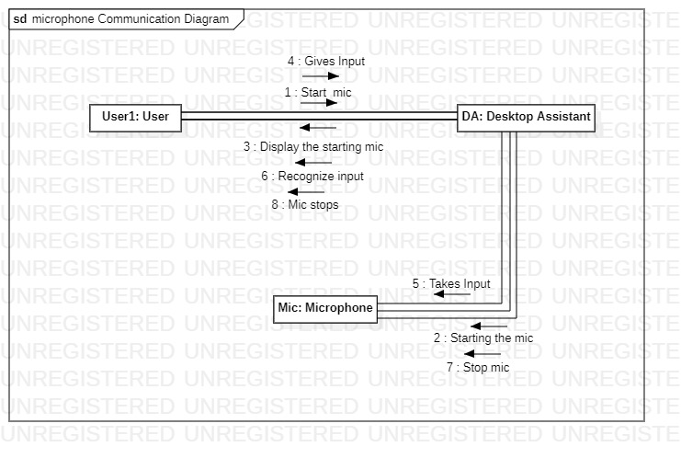
Communication Diagram 1. Microphone

Slide 16
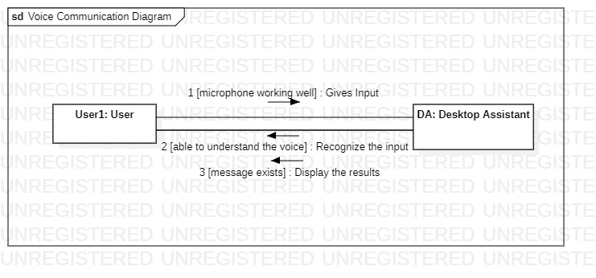
2.Voice

Slide 17
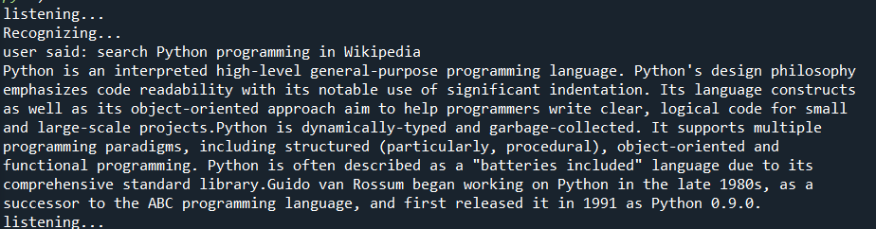
Searching Wikipedia

Slide 18
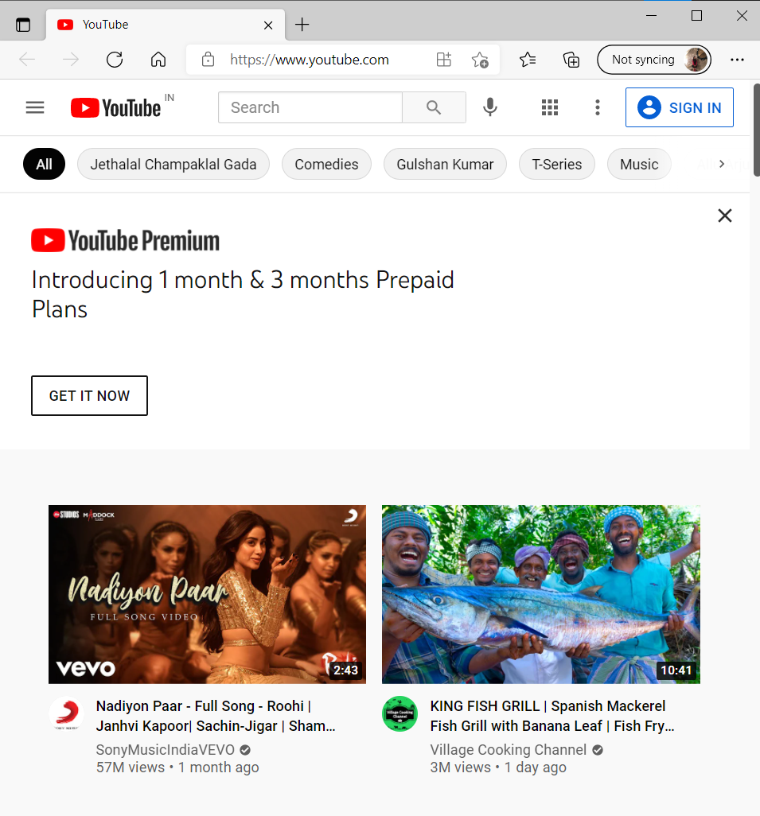

Opening Youtube

Slide 19
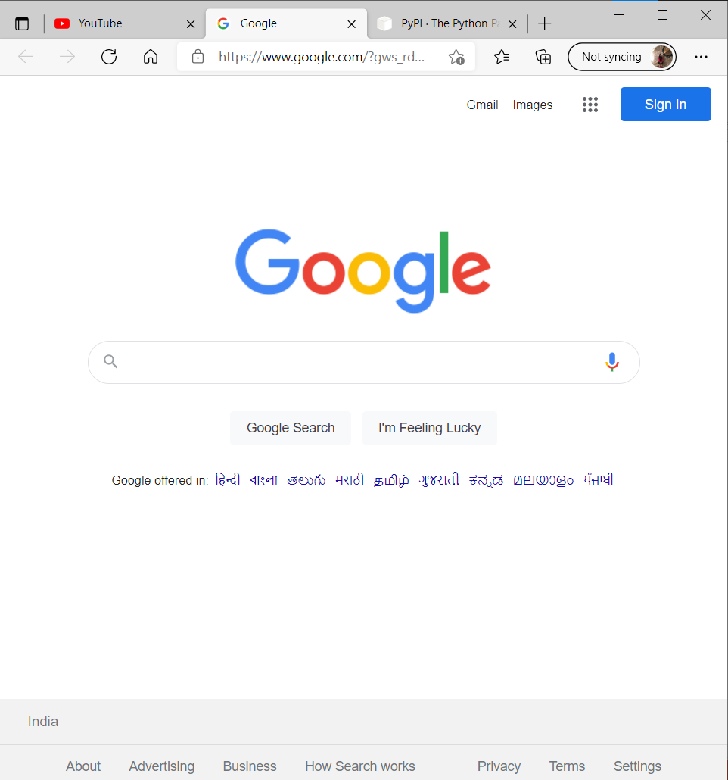

Opening Google Search

Slide 20
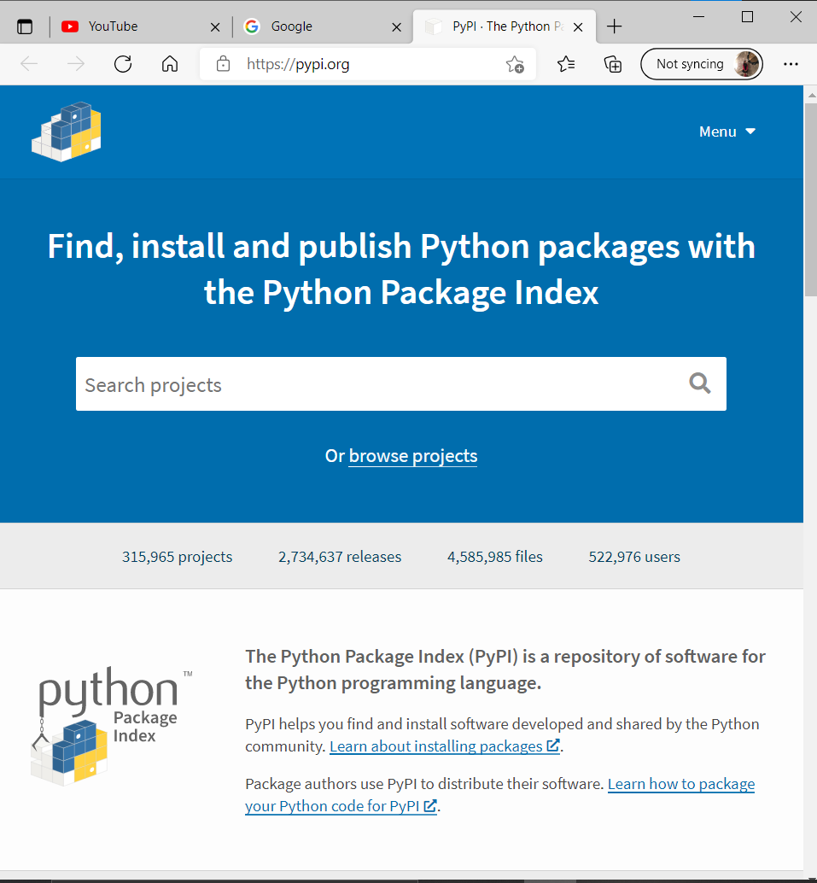

Python Website

Slide 21

Current Time

Slide 22
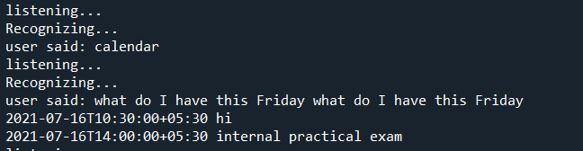
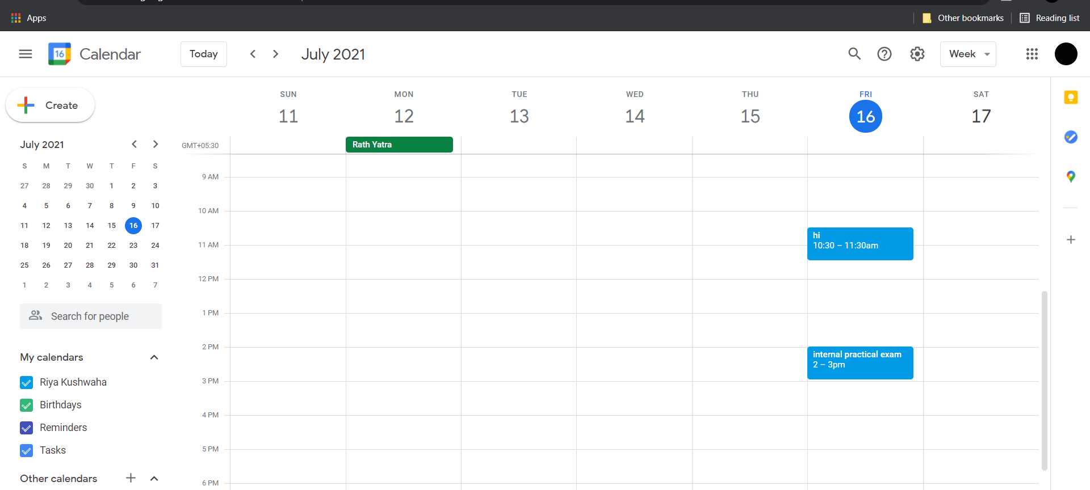
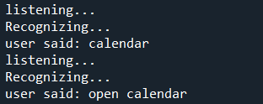
Calendar

Slide 23
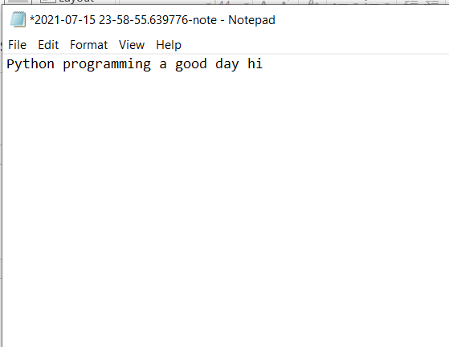

Open notepad and speak, the assistant writes

Slide 24
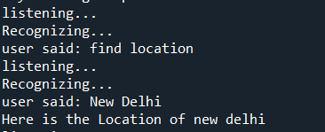
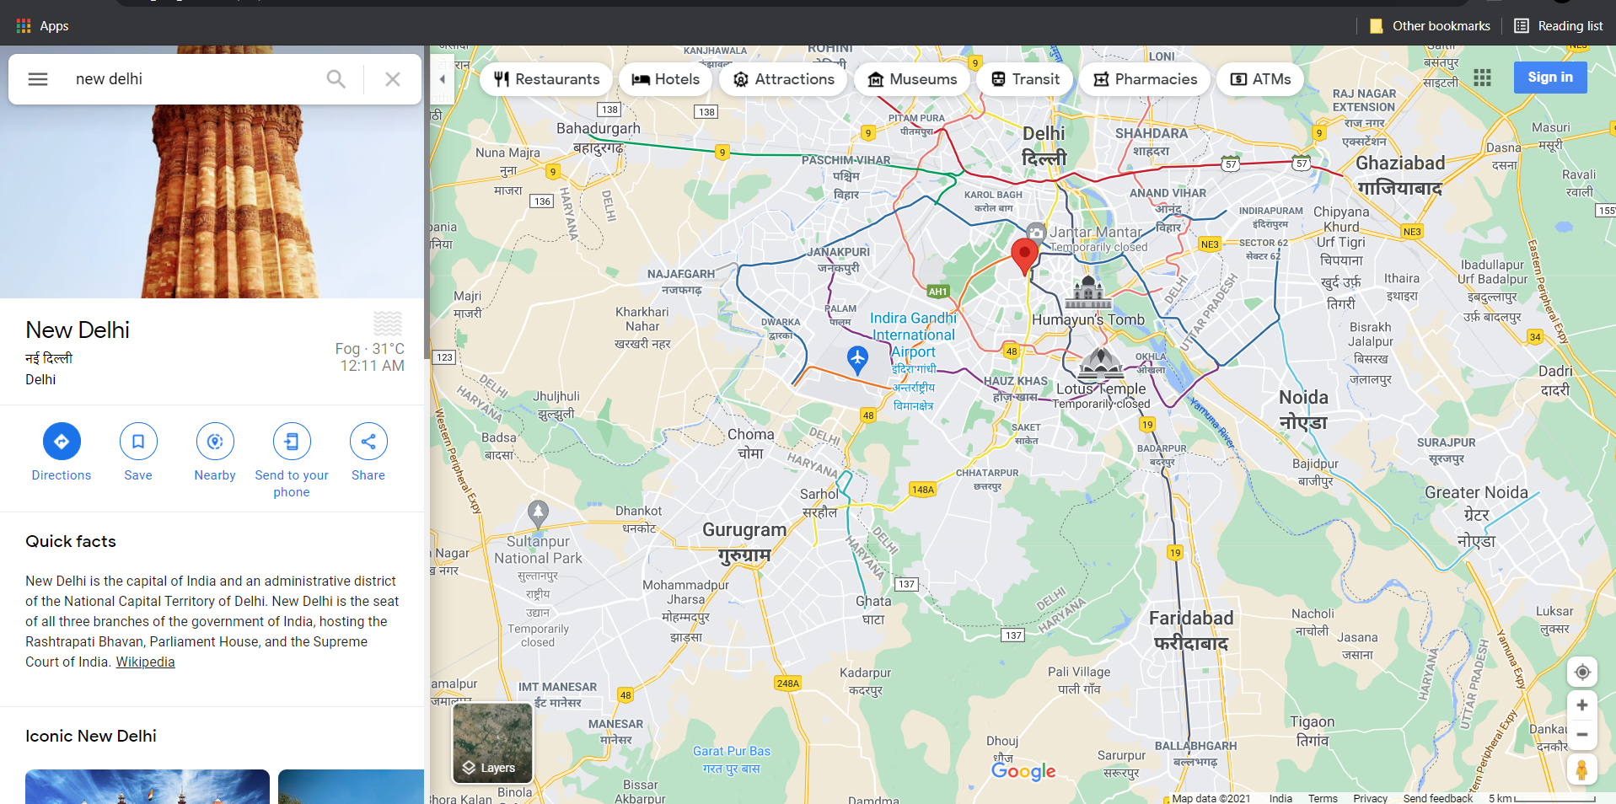
Finding location in google maps

Slide 25

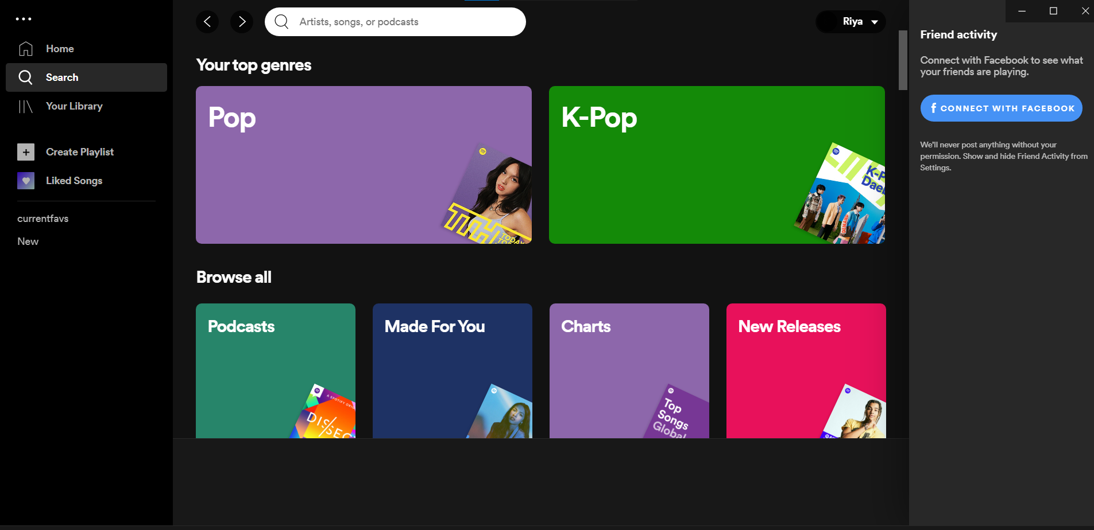
Open Spotify

Slide 26
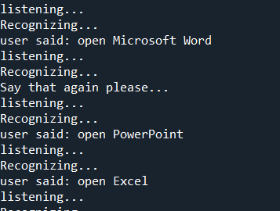
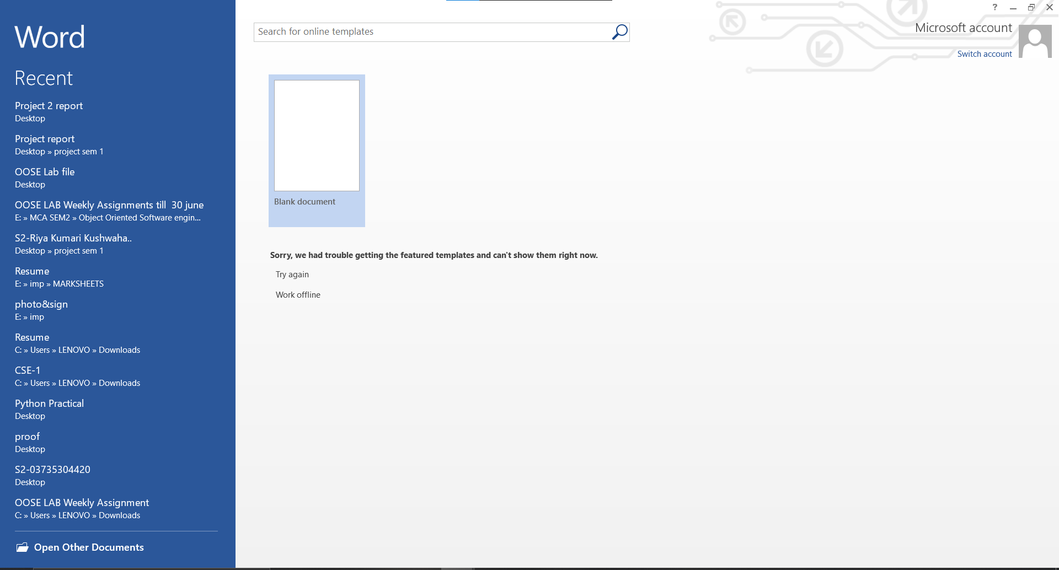
Microsoft Office Applications

Slide 27
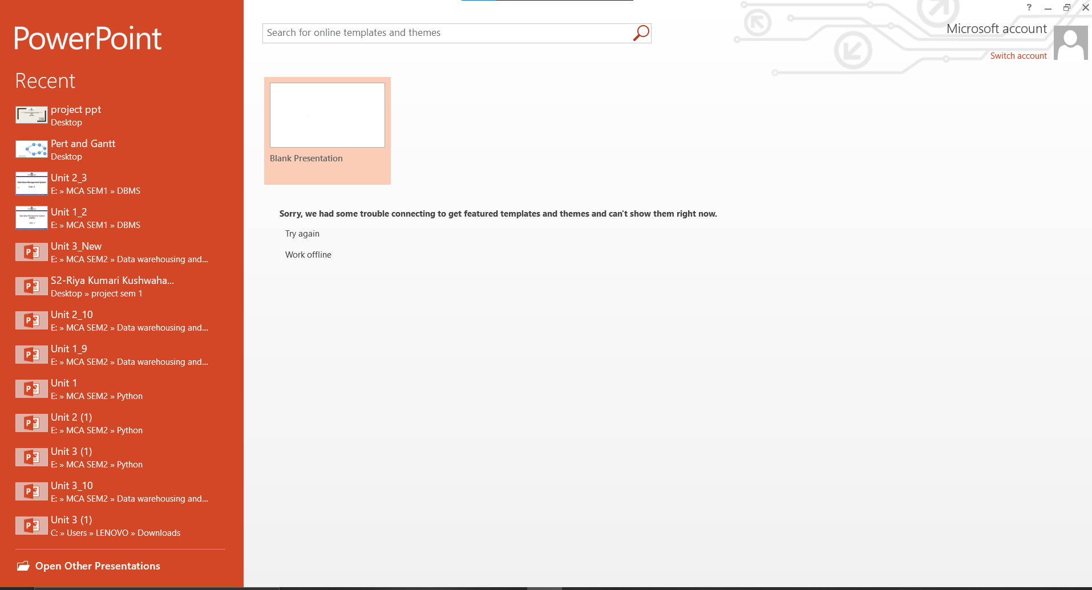
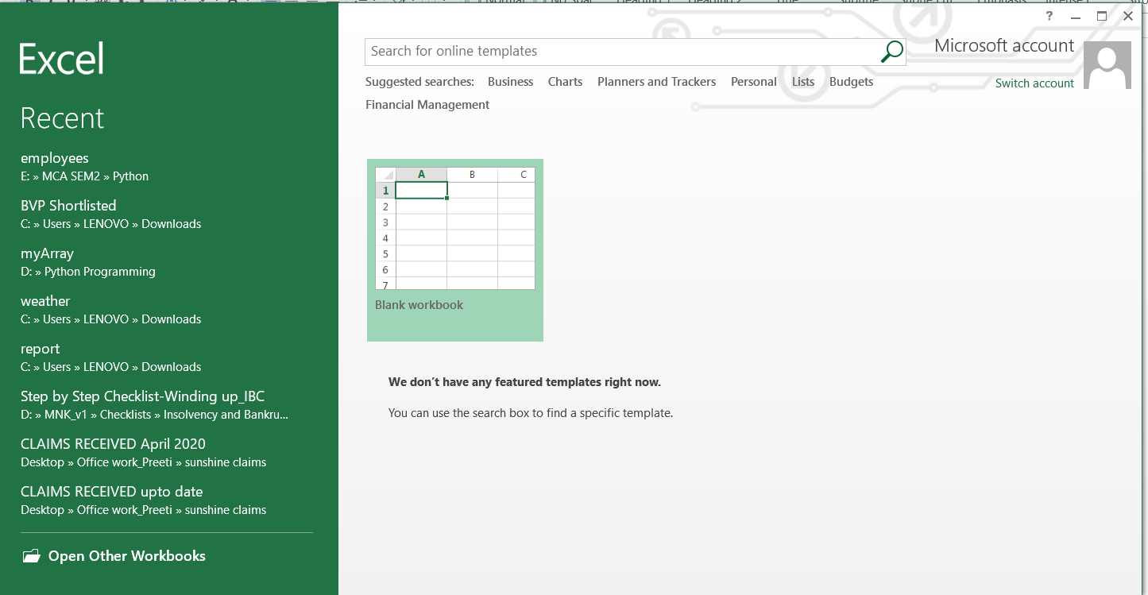

Slide 28
Technology Used
Python3
Google Calendar API
Google Maps

Slide 29
Future Scope and Conclusion
Future Scope
The desktop voice assistant has made the task of human easier . It still lacks few features such as opening camera and sending mails which can we included later.
Conclusion
Desktop assistant software improves user productivity by managing routine tasks of the user and by providing information from online sources to the user. Building an agent that can replace a human assistant has been a holy grail for software industry, especially in the field of artificial intelligence.

Slide 30
Bibliography
[1] Introduction to programming using Python
[2] Exploring Python by Timothy A. Budd
[3] https://pypi.org/project/SpeechRecognition/
[4] https://stackoverflow.com/
[5] https://www.geeksforgeeks.org/

